Slide 1





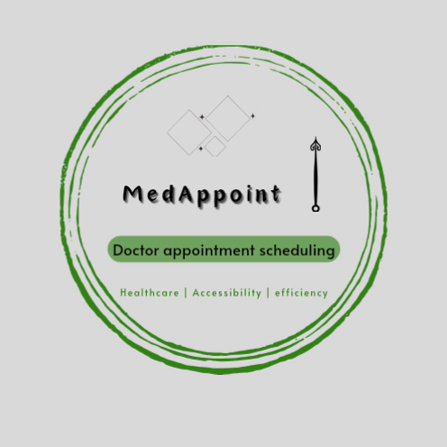
MEDAPPOINMENTS
Team Members: Guide : Umamaheswari
Sarguna Sundhari E
Sivasankari E
Thanga Swetha M
VISALI T
Disclaimer: The content is curated for educational purposes only.

Slide 2
OUTLINE
Abstract
Problem Statement
Aims, Objective & Proposed System/Solution
System Design/Architecture
System Development Approach (Technology Used)
Algorithm & Deployment
Conclusion
Future Scope
References
Video of the Project
Notes:
These are the list of chapters that we are going to cover in these foundation codes. Those are chapter one what are AI and ML? chapter 2 applied Python programming in AI, and chapter 3 is exploratory data analysis for ML.

Slide 3
Abstract: The purpose of the entitled as “MEDAPPOINMENTS” is to computerize the front office management of hospital to develop software which is user friendly simple , fast and cost effective. It deals with the collection of patient information ,diagnosis details etc . Traditionally it was done manually . The main function of the system is register and store patient details and doctor details and retrieve these details as and when required and also to manipulate these details meaningfully system input contains patient details. Diagnosis details while system output is to get these details on to the screen . The doctor appointment system can be entered using a username and password . It is accessible either by an administrator or receptionist . Only they can add into the database. The data can be retrieved easily . The data are well protected for personal use and makes the data processing very fast .

Slide 4
Problem Statement: The challenge is to streamline and simplify the process of scheduling doctor appointments for patients . Traditional methods often involve time consuming phone calls and manual record keeping this project aims to create a digital solution that enhances the efficiency of Appoinments scheduling , reduces wait time , and improve overall patient experience .

Slide 5
Aim and Objective: To give a “ MedAppointments ” will be a java based applications addressing the complexities of doctors appointment scheduling . Online doctor appointment Electronic medical record Reserved time and date for each doctors patients interface(see available slots and request an appointment) Doctor’s management interface Medical diagnosis report and medical suggestion , etc will be given to patient via email and other media and will be stored in the clinical center database as well . Manager’s managements interface .

Slide 6
Proposed Solution: USER AUTHENTICATION : Patient can create accounts , log in , and manage their profiles . DOCTOR DATABASE : Implement a database to store details to doctors , including specialties , availability , and contact information . APPOINTMENT SCHEDULING : Allow patients to view doctor availability and schedule appointments at their convenience . APPOINTMENTS REMINDERS : Implements a reminder system to notify patients of upcoming appointments through emails and SMS . PATIENT HISTORY : Maintain a record of patient appointment history making it easier for both patients and doctors to track medical visits . ADMIN PANEL : Provide an admin interface for managing doctor details appointments schedules and resolving scheduling conflicts . SECURE DATA HANDLING : Implements robust security measure to protect patient and doctor information . USER FEEDBACK :. Allow patients to provide feedback on their appointments facilities continuous improvement .

Slide 7

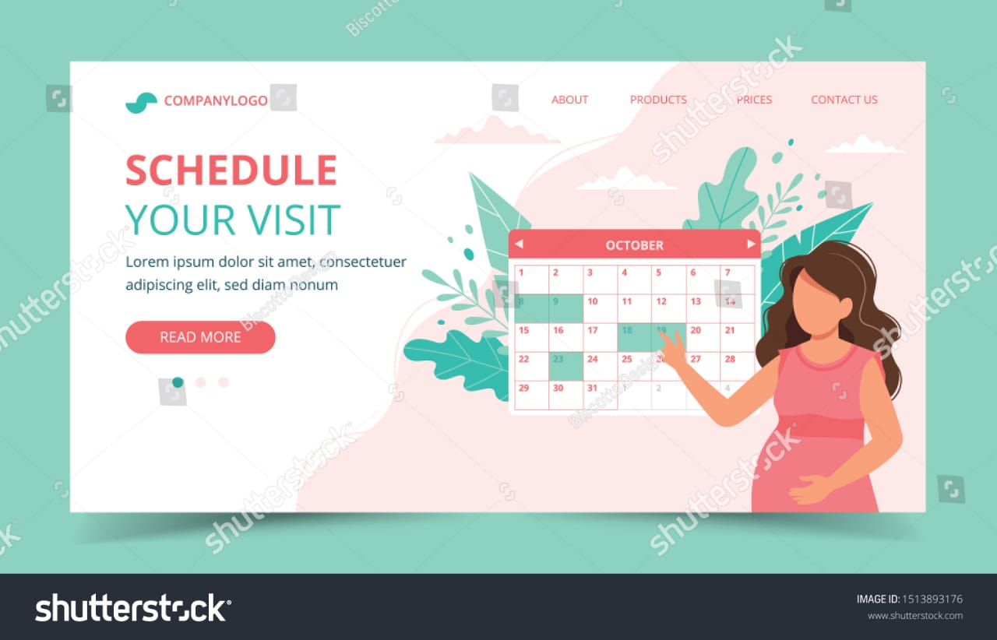




System Architecture:

Slide 8
System Deployment Approach: Deploying a medical appointment system involves several steps . Firstly , assess your system requirements , choose a secure hosting environment , and ensure compliance with healthcare regulations . Develop and test the applications , then deploy it using a phased approach, starting with a small user group . Monitor performance , gather feedback , and make any necessary adjustments for a smooth rollout . Regularly update and maintain the system to address evolving needs and security concerns .

Slide 9
Algorithm & Deployment: 1.PATIENT REGISTRATION : Collect patient information . Assign a unique identifier to each patient . 2.APPOINTMENT SCHEDULING : Define available time slot for appointment . Allow patient to choose a suitable time slot .check for conflicts to avoid double booking . 3.CONFIRMATION AND REMINDERS : Send confirmation for upcoming appointments . DEPLOYMENT : 1.CHOOSE HOSTING SERVICE :Select a hosting provider(eg AWS) for deploying your node Jsapplication. 2.ENVIRONMENT CONFIGURATION : Ensure environment variables are set for sensitive information (database credentials , API keys ) . 3.DATABASE DEPLOYMENT : Deploy and configure your selected database service . 4.CONTINUOUS DEPLOYMENT : use tool like Jenkins,GitHub actions for automated deploymen whenever code changes. 5.MONITORING AND SCALING: Implement monitoring tools to track performance.Be prepare to scale based on demand . 6.SECURITY CONSIDERATIONS: Apply security best practices to protect patient data .regularly update dependencies to address vulnerabilities. 7.COMPLIANCE WITH REGULATIONS . 8.TESTING .

Slide 10
Conclusion: User can see the schedule date , time and serial no . Doctor can see how much appointment he get for a specific day . Patients are able to book and manage their own appointment with ease . This system helps in taking appointment at a distant and get the details online via mobile and desktops . This system helps solving the long waiting for appointment with doctors and keeping the file of prescriptions and report that get lost many time . This system helps in our busy life taking appointments and keeping health record in easy and in best safe way .

Slide 11

Future Scope: Seamless integration with electronic medical records systems . EMRs store patient health information , medical history , and treatment plans , allowing doctors to access and update relevant data during virtual consultations . Advancements in telemedicine , AI driven scheduling system , personalized health apps , and improved patient doctors communication platform to enhance accessibility and efficiency in healthcare service .

Slide 12
Reference:
https://www.youtube.com/playlist?list=PLHmESvg2HbgcnKfLCpzZSUp7tfTI2d_pi
http://www.youtube.com/watch?v=bpklSyx75M
http://stachoverflow.com/questions/19619428/html-form-validation-pattern-alphanumeric-with-spaces
Notes:
Reference
These are the references for this session.
12

Slide 13
Thank you!
Notes:
thank you very much for joining this PPT, keep learning.
13

